Slide 1

Introduction to Computer System Validation
Presented by:
Compliance Department

Slide 2
Introduction to Computer System Validation
Course Content
What is Computer System Validation (CSV)?
System Development Life Cycle (SDLC)
Origin
Validation Processes
Phases & Deliverables
Types of CSV
Q & A Session

Slide 3
Introduction to Computer System Validation
What is CSV?
Validation is documented evidence which provides a high degree of assurance that a specific process will consistently produce a product meeting its predetermined specifications and quality attributes.
CSV is determination of the correctness of the final program or software produced from a development project with respect to the user needs and requirements. Validation is usually accomplished by verifying each stage of the software development life cycle.
FDA Glossary of Computer System Software Development Terminology (8/95)

Slide 4
Introduction to Computer System Validation
Validation Processes
There are three validation processes, which provide methods for validating computer systems. Each validation process utilizes phases of the SDLC.
The Prospective Validation Process provides a path for validating a new computer system.
The Maintenance Validation Process provides a means for controlling, updating, maintaining, and retiring a currently validated system.
The Retrospective Evaluation Process provides a means for bringing legacy systems into a controlled, maintainable and validated state.

Slide 5
Introduction to Computer System Validation
The Prospective Validation Process
The Prospective Validation Process applies to the development of new computer systems. The result will be a computer system that is validated and provides the documentation necessary to maintain the system after acceptance.
The phases of the SDLC will be used to define system requirements and design; define hardware, software and the necessary interfaces to implement the system; and to provide objective evidence of all test activities performed.

Slide 6
Introduction to Computer System Validation
The Maintenance Validation Process
The Maintenance Validation Process applies to all changes to computer systems, which have successfully completed the Prospective validation Process or Retrospective Evaluation Process.
When a change to a validated system is received, process flow will return to the phase affected within the Prospective Validation Process. This process requires that the change is documented, reviewed and approved; appropriate requirements, design and test documentation are created or updated; and adequate testing of the updated system is performed.

Slide 7
Introduction to Computer System Validation
The Retrospective Evaluation Process
The Retrospective Evaluation Process is for systems, which were not developed using the Prospective Validation Process. This process does not present an alternative to the Prospective Validation Process, but rather uses select phases in the Prospective Validation Process to retrospectively validate a computer system already in existence. This process applies to:
Systems that were developed in a manner inconsistent with the Prospective Validation Process.
Systems where the system documentation is insufficient.
Systems where the test documentation is insufficient.
Previously validated systems that changed in a manner, which is inconsistent with the Maintenance Validation Process.

Slide 8
Introduction to Computer System Validation
The Retrospective Evaluation Process (cont.)
The objective of the Retrospective Evaluation Process is to review existing requirements and design documentation, to update or create documentation to support the current design of the system, and to establish system reliability and confidence throughout testing.

Slide 9
Introduction to Computer System Validation
What is System Development Life Cycle (SDLC)?
SDLC is a series of steps observed by developers on building specific software. Developers follow certain steps to ensure they have the right software for the right demand.
Geek Interview (2014)

Slide 10
Introduction to Computer System Validation
Systems Development Life Cycle (SDLC)
(Origin)
The history of the term “SDLC” is very vague but it naturally came into being since the 1960s when developers started to create programs specific to a certain need.
Slowly, the term has been observed by different software development companies. From a simple format of planning, building, testing and implementing, software companies have developed their own version of developing specific products for their clients.
FDA started using the phases approach (associated mainly with “Waterfall”) since the publication of the “Blue book” in February 1983, which was their first serious initiative for CSV.

Slide 11
Introduction to Computer System Validation
Systems Development Life Cycle (SDLC)
A SDLC approach will be followed for computer system development projects. During the validation process, an assessment will be made to determine the criticality and complexity of the change.
Based on the criticality and complexity, the validation process will be tailored to ensure that the appropriate phases, level of documentation, and level of testing are completed.
It should be noted that these phases might not always be independent. Some overlapping of phases may be appropriate in any given project, and all phases may not be required for every project.

Slide 12
Introduction to Computer System Validation
System Development Life Cycle (SDLC) – (cont.)
The SDLC covers all the phases of a computer system’s life and shall apply equally to new products as well as to components of existing systems which are being updated or modified.
Dependent upon the size of the project, the time spent in each phase will vary.

Slide 13
Introduction to Computer System Validation
System Development Life Cycle (SDLC) – (cont.)
The phases could be defined as follows:
Concept,
Project Planning and Initiation,
Requirements Definition,
Functional/Design Specifications,
Coding/Construction,
Testing,
Implementation,
Maintenance, and
Retirement

Slide 14
Introduction to Computer System Validation
System Development Life Cycle (SDLC) – (cont.)
(Phases & Deliverables)
1. Concept Phase
In the Prospective Validation and Retrospective Evaluation Processes, a concept of the computer system is developed. The department management who see a need to improve productivity, functionality and/or quality of a business process usually initiates this.
In the Maintenance Validation Process, a change request to enhance or amend an existing computer system initiates this phase. These requests can come from any area in the organization (e.g., Quality & Compliance, Information Technology, Engineering, among others), which uses the system or has the need for new computerization.

Slide 15
Introduction to Computer System Validation
System Development Life Cycle (SDLC) – (cont.)
(Phases & Deliverables)
1. Concept Phase (cont.)
The original concept is reviewed and updated if necessary. This phase is primarily the responsibility of the System Owner. A new or updated concept document is produced during this phase.
During the Concept Phase, a Risk Analysis Review evaluates the risk factors involved with computerizing a manual process or with the purchase or enhancement of a computer system.

Slide 16
Introduction to Computer System Validation
System Development Life Cycle (SDLC) – (cont.)
(Phases & Deliverables)
1. Concept Phase (cont.)
Some of the items to consider when conducting the risk analysis include:
regulatory areas of the system,
size of the computer system and number of users,
complexity of the system in terms of the design,
type of data the system handles,
functionality of the system,
vendor reliability,
effect/impact of system non-compliance, and
safety to the customer, employee, and community

Slide 17
Introduction to Computer System Validation
System Development Life Cycle (SDLC) – (cont.)
(Phases & Deliverables)
1. Concept Phase (cont.)
In order to move on to the next phase, a documented risk analysis review should be approved by appropriate personnel; for instance, at minimum by the System Owner and Quality Assurance management.
The documentation deliverable (output) for this phase is:
Risk Analysis Review

Slide 18
Introduction to Computer System Validation
System Development Life Cycle (SDLC) – (cont.)
(Phases & Deliverables)
2. Project Planning and Initiation Phase
The purpose of the Project Planning and Initiation Phase is to initiate a request and develop the project plan for the development, validation, or maintenance of a computer system.
During this phase, a Project Plan will be written by the primary department developing the system to describe:
responsible departments and/or individuals,
resources availability,
time restrictions,
costs,
development schedule, and
timeline for the final product

Slide 19
Introduction to Computer System Validation
System Development Life Cycle (SDLC) – (cont.)
(Phases & Deliverables)
2. Project Planning and Initiation Phase (cont.)
The Project Plan will include the SDLC phase implementation and all validation activities.
In order to move on to the following phase, a Project Plan shall be approved and executed by appropriate personnel. The documentation deliverables (outputs) for this phase are:
Change Control Request
Project (Validation) Plan

Slide 20
Introduction to Computer System Validation
System Development Life Cycle (SDLC) – (cont.)
(Phases & Deliverables)
Requirements Definition Phase
This is the most crucial phase of a project and its primary objective is to transform the system concept or project initiation request into clear and measurable requirements, which may be gathered from the department users, the System Owner, and other relevant departments.
Requirements describe what the system will do, not how. In order to effectively define the requirements, it is essential that the process of the computer system is fully understood.

Slide 21
Introduction to Computer System Validation
System Development Life Cycle (SDLC) – (cont.)
(Phases & Deliverables)
Requirements Definition Phase (cont.)
In the Prospective Validation Process, the requirements of the proposed system are defined.
In the Retrospective Evaluation Process, the requirements of the current system are captured.
In the Maintenance Validation Process, if the original system’s requirements have changed, the requirements documentation will be updated to reflect the changes.

Slide 22
Introduction to Computer System Validation
System Development Life Cycle (SDLC) – (cont.)
(Phases & Deliverables)
Requirements Definition Phase (cont.)
Requirements may be broken into several categories, such as:
user/business requirements,
system/project requirements,
functional requirements, and
regulatory/standard requirements

Slide 23
Introduction to Computer System Validation
System Development Life Cycle (SDLC) – (cont.)
(Phases & Deliverables)
Requirements Definition Phase (cont.)
For those computer systems purchased from an outside vendor, a Vendor Audit should be conducted to evaluate potential vendors and, determine the reliability of the vendor’s product and quality system.
Written vendor contracts shall be prepared for GxP computer system development, installation, maintenance, and support.
Prior to contract signing, the vendor shall be informed of computer system validation requirements.

Slide 24
Introduction to Computer System Validation
System Development Life Cycle (SDLC) – (cont.)
(Phases & Deliverables)
Requirements Definition Phase (cont.)
Another deliverable, a Validation Plan must be prepared for each GxP computer system and driven by a completed understanding of the process in which the computer system is used.
This document states what activities were performed or will be performed in order to ensure that computer system is developed consistent with software quality processes and procedures, and that the system is validated. It describes the process control system strategy, rationale and key acceptance criteria.

Slide 25
Introduction to Computer System Validation
System Development Life Cycle (SDLC) – (cont.)
(Phases & Deliverables)
Requirements Definition Phase (cont.)
In order to move on to the next phase, the following documents shall be approved by appropriate personnel. The documentation deliverables (outputs) for this phase are:
Requirements Document, and
Vendor Audit Plan & Report

Slide 26
Introduction to Computer System Validation
System Development Life Cycle (SDLC) – (cont.)
(Phases & Deliverables)
4. Functional/Design Specifications Phase
The functional specifications document is a “high-level” translation of the requirements to expected operation of the computer system. For instance, appropriate operation’s sequence or parameters’ ranges.
The functional specifications document will lead to create the design specifications for custom programs.
The system functional and design specifications documents are developed during the first life cycle of the product and are amended in each subsequent life cycle of the product, when changes or modifications to the system are made.

Slide 27
Introduction to Computer System Validation
System Development Life Cycle (SDLC) – (cont.)
(Phases & Deliverables)
4. Functional/Design Specifications Phase (cont.)
The system design specification will identify properties such as the overall system architecture, computer language, interfaces, screen designs, algorithms, and security measures.
Further design effort may include system structure diagrams, input and output (I/O) diagrams, engineering drawings, flow charts, program hierarchy charts, detail specifications and a data dictionary.
In the Maintenance Validation Process, changes to the original system are updated in existing functional and design documentation or generated as required.

Slide 28
Introduction to Computer System Validation
System Development Life Cycle (SDLC) – (cont.)
(Phases & Deliverables)
4. Functional/Design Specifications Phase (cont.)
In the Retrospective Evaluation Process, design documents are updated or created according to the complexity and criticality, as determined in the Risk Analysis Review.
Consequently, in order to go to the next phase, a system design specifications document shall be approved and executed by appropriate personnel.
The documentation deliverables (outputs) for this phase are:
Functional Specifications Document
Design Specifications Document (only for custom systems)

Slide 29
Introduction to Computer System Validation
System Development Life Cycle (SDLC) – (cont.)
(Phases & Deliverables)
5. Coding / Construction Phase
References back to the design documents will be made to ensure that defined processes and functions are being coded accurately.
Programming standards and naming conventions shall be utilized during this phase and code reviews conducted to ensure adherence to these standards.
Throughout this phase, developers perform unit and integration testing. System Functions are typically broken down into smaller processes called modules.

Slide 30
Introduction to Computer System Validation
System Development Life Cycle (SDLC) – (cont.)
(Phases & Deliverables)
5. Coding / Construction Phase (cont.)
Once the individual modules have been created and unit tested, they are integrated into a single unit.
As each module is connected, integration testing is done to ensure that the module not only function, but that it function correctly when attached to another module.
After all the modules have been linked together, a System Test Plan is executed on the system as a whole to ensure its proper operation (refer to Testing Phase).

Slide 31
Introduction to Computer System Validation
System Development Life Cycle (SDLC) – (cont.)
(Phases & Deliverables)
5. Coding / Construction Phase (cont.)
In the Prospective Validation and Retrospective Evaluation Processes, system administration procedures and user manuals are prepared and system installation tasks are addressed.
In the Maintenance Validation Process, the existing system maintenance procedures and system installation plan are updated.

Slide 32
Introduction to Computer System Validation
System Development Life Cycle (SDLC) – (cont.)
(Phases & Deliverables)
5. Coding / Construction Phase (cont.)
Again, to move on to the next phase, the following document shall be approved by appropriate personnel. The documentation deliverable (output) for this phase is:
System’s Source Code

Slide 33
Introduction to Computer System Validation
System Development Life Cycle (SDLC) – (cont.)
(Phases & Deliverables)
6. Testing Phase
The System Testing is a phase at which all components of the system are combined and evaluated to determine whether or not the system performs according to the documented requirements and design.
This testing will be completed in an environment that simulates the operating environment, but may be performed in the actual operating environment if product is not at risk or is properly segregated. This phase is required for all validation processes.

Slide 34
Introduction to Computer System Validation
System Development Life Cycle (SDLC) – (cont.)
(Phases & Deliverables)
6. Testing Phase (cont.)
The purpose of system testing is to discover and correct as many errors as possible. Objectivity and independence will be established between development, test, review and audit personnel when possible.
Test scenarios shall be defined and include a test objective, test data, step descriptions, and expected results.
Each test scenario shall reference the requirement(s) being tested to establish traceability to ensure that all requested functions are present in the system.

Slide 35
Introduction to Computer System Validation
System Development Life Cycle (SDLC) – (cont.)
(Phases & Deliverables)
6. Testing Phase (cont.)
In order to move on to the next phase, the following documents should be approved by appropriate supplier’s and customer’s personnel. The documentation deliverables (outputs) for this phase are:
System Testing (evidence provided by developer)
Factory Acceptance Testing (not mandatory), and
Site Acceptance Testing (not mandatory)

Slide 36
Introduction to Computer System Validation
System Development Life Cycle (SDLC) – (cont.)
(Phases & Deliverables)
7. Implementation Phase
The computer system is installed in a development/test environment and tested according to the Qualification Protocols.
This area is separated from the production environment or can be the production environment, but temporary “out-of-use” to ensure that any problems, which may occur, will not adversely affect any previously recorded data.

Slide 37
Introduction to Computer System Validation
System Development Life Cycle (SDLC) – (cont.)
(Phases & Deliverables)
7. Implementation Phase (cont.)
Procedures shall be written for all personnel involved in the installation, operation and maintenance of the computer system. These procedures may cover, among other topics:
System Installation and Operation
Backup & Restore
Disaster Recovery Plan, and
System Security

Slide 38
Introduction to Computer System Validation
System Development Life Cycle (SDLC) – (cont.)
(Phases & Deliverables)
7. Implementation Phase (cont.)
Training plans shall be established for all personnel involved in the operation and maintenance of the computer system. Personnel will include, but not be limited to, system users, developers/programmers, maintenance, and support.
All personnel will be trained in respect to their assigned tasks and to any new/modified SOPs prior to release the system to the production environment.

Slide 39
Introduction to Computer System Validation
System Development Life Cycle (SDLC) – (cont.)
(Phases & Deliverables)
7. Implementation Phase (cont.)
Qualification consists of executing the V-model:
Installation testing and verifications matching design specifications,
Operational testing matching functional specifications, and
Performance testing (user’s acceptance testing) matching requirements.
These qualification activities may be separated or combined into a single protocol (testing and verifications document) based on the system’s complexity. In the latest case, a single report may summarize all qualification testing/verifications and results.

Slide 40
Introduction to Computer System Validation
System Development Life Cycle (SDLC) – (cont.)
(Phases & Deliverables)
7. Implementation Phase (cont.)
The Installation Qualification (IQ) establishes confidence that process equipment (which includes hardware and software) and ancillary systems are compliant with appropriate codes and approved design intentions, and that manufacturer’s recommendations are suitably considered.
An IQ Report shall document the results of the execution of the IQ Protocol and report if the acceptance criteria were satisfied. All system software shall be archived and application software placed in version control upon installation.

Slide 41
Introduction to Computer System Validation
System Development Life Cycle (SDLC) – (cont.)
(Phases & Deliverables)
7. Implementation Phase (cont.)
The Operational Qualification (OQ) establishes confidence that process equipment (which includes hardware and software) and subsystems are capable of consistently operating within manufacturer’s ranges and tolerances.
An OQ Report shall document the results of the execution of the OQ Protocol and report if the acceptance criteria were satisfied.

Slide 42
Introduction to Computer System Validation
System Development Life Cycle (SDLC) – (cont.)
(Phases & Deliverables)
7. Implementation Phase (cont.)
The Performance Qualification (PQ) establishes that the process is effective and reproducible within requirement’s limits and tolerances – which are normally much more restricted than the manufacturer’s ranges and tolerances.
The PQ is conducted in the current production environment.
A Traceability Matrix is developed to ensure that all requirements are covered and challenged during the validation process. For instance, from requirements to functional/design specifications, and to installation/operational/performance qualification testing.

Slide 43
Introduction to Computer System Validation
System Development Life Cycle (SDLC) – (cont.)
(Phases & Deliverables)
7. Implementation Phase (cont.)
Any policies or SOPs, which must be modified or created for implementation of the new or enhanced computer system, shall be modified or created for implementation of the new or enhanced computer system must be identified and updated prior to PQ.
All training of appropriate personnel must also be completed and documented prior to PQ.

Slide 44
Introduction to Computer System Validation
System Development Life Cycle (SDLC) – (cont.)
(Phases & Deliverables)
7. Implementation Phase (cont.)
Once the acceptance criteria of PQ are satisfied, a report is issued summarizing the results and indicating that the system has completed its validation process.
After above activities, a formal release of the computer system is required. This is performed by generating a Validation Report, which should include a review that all deliverables stated in the Validation Plan are complete and approved by all required parties.
The approval of the Validation Report may release the system to the production environment.

Slide 45
Introduction to Computer System Validation
System Development Life Cycle (SDLC) – (cont.)
(Phases & Deliverables)
7. Implementation Phase (cont.)
The documentation deliverables (outputs) for this phase are:
Installation Qualification (IQ) Protocol & its summary report,
Operational Qualification (OQ) Protocol & its summary report,
Performance Qualification (PQ) or User Acceptance Testing Protocol & its summary report,
Requirements Traceability Matrix
Procedures,
Training on procedures
Validation Report

Slide 46
Introduction to Computer System Validation
System Development Life Cycle (SDLC) – (cont.)
(Phases & Deliverables)
8. Maintenance Phase
The Maintenance Phase of the SDLC is entered once the computer system is released to the production environment.
This phase covers the activities associated with the monitoring and modifying the system in an operational state.
Appropriate measures must be taken to ensure that a GxP computer system remains in a “validated state” during its operational use.

Slide 47
Introduction to Computer System Validation
System Development Life Cycle (SDLC) – (cont.)
(Phases & Deliverables)
8. Maintenance Phase (cont.)
A number of documents will be generated during the production lifetime of the system. These documents will demonstrate to regulatory agencies and internal quality auditors that computer system is functioning as expected, problems are addressed in a timely manner, data integrity is assured, and that the System Owner is in control of the system and its operating environment.

Slide 48
Introduction to Computer System Validation
System Development Life Cycle (SDLC) – (cont.)
(Phases & Deliverables)
8. Maintenance Phase (cont.)
The following activities will be addressed during the Maintenance Phase:
An Incident Report Form will identify what the problem is; when/how it was encountered, and will have attached any examples of the problem (as applicable).
Once resolved, these forms must be maintained and made available with the system documentation. The resolution of a problem may generate a change request.

Slide 49
Introduction to Computer System Validation
System Development Life Cycle (SDLC) – (cont.)
(Phases & Deliverables)
8. Maintenance Phase (cont.)
Change Control Request will be achieved by documenting all changes made to the computer system, no matter how minor, since being released into production use. Each change request should contain at least the following information:
why the change is needed,
who authorized the change,
what the change is, who made the change, and
any testing/re-validation required due to the change.

Slide 50
Introduction to Computer System Validation
System Development Life Cycle (SDLC) – (cont.)
(Phases & Deliverables)
8. Maintenance Phase (cont.)
Procedures for both adding and removing users will be defined.
While the Backup/Archive/Disaster Recovery procedures will document the scheduled backup of the computer system, restoration procedures, archival requirements, off-site storage of media, and disaster recovery procedures/contingency plan in the event of the loss of the computer system.

Slide 51
Introduction to Computer System Validation
System Development Life Cycle (SDLC) – (cont.)
(Phases & Deliverables)
8. Maintenance Phase (cont.)
Maintenance Logs will detail any scheduled or unscheduled maintenance performed to the computer system.
These logs will be reviewed periodically to ensure that all maintenance has been documented to identify any need for revalidation due to the change in the operating environment.

Slide 52
Introduction to Computer System Validation
System Development Life Cycle (SDLC) – (cont.)
(Phases & Deliverables)
8. Maintenance Phase (cont.)
Periodic reviews will take place to ensure that company policies and procedures are being followed, and that system documentation is up-to-date and accurately reflects the current computer system.
Training should be required for new personnel that become involved with the computer system, including development, maintenance, support and user/operations personnel. Training records will be maintained.

Slide 53
Introduction to Computer System Validation
System Development Life Cycle (SDLC) – (cont.)
(Phases & Deliverables)
Maintenance Phase (cont.)
The documentation deliverables (outputs) for this phase are:
Incident Report Forms,
Change Control Requests,
Periodic Reviews, and
Training Records

Slide 54
Introduction to Computer System Validation
System Development Life Cycle (SDLC) – (cont.)
(Phases & Deliverables)
9. Retirement Phase
When it has been determined by the System Owner that a computer system is no longer appropriate for the function it is currently performing or that a new system should be implemented to perform the functions currently being managed, the system shall be retired from active use.
The objective of this phase is to eliminate dependence on the system and to provide a means of retrieval of any stored GxP-related data generated by the system. This represents the final phase of the SDLC.

Slide 55
Introduction to Computer System Validation
System Development Life Cycle (SDLC) – (cont.)
(Phases & Deliverables)
9. Retirement Phase (cont.)
The System Owner will generate a project plan identifying what steps will be taken to retire the system, what will replace the current system, timelines for the retirement process, the individuals responsible for the retirement process.
The rationale for retirement the system will also be documented.
If the system is being replaced by another system, the archived data may be loaded into the replacement system. Verification of the successful data migration will be demonstrated as part of the validation process of the new system.

Slide 56
Introduction to Computer System Validation
System Development Life Cycle (SDLC) – (cont.)
(Phases & Deliverables)
9. Retirement Phase (cont.)
A System Retirement Report detailing the steps performed to retire the system from use and where the system software and information will be archived and approved by the appropriate authority.
In addition, the following activities should be completed:
remove access to the system,
clean up any system logical/symbols/menu references,
delete the software and any associated files from the system,
notify all affected functional areas that it is necessary to retire any system specific procedures, and
discontinue regular system support activities

Slide 57
Introduction to Computer System Validation
System Development Life Cycle (SDLC) – (cont.)
(Phases & Deliverables)
9. Retirement Phase (cont.)
The documentation deliverables (outputs) for this phase are:
System Retirement Plan, and
System Retirement Report

Slide 58
Introduction to Computer System Validation
Types of CSV
There are the types of CSV performed within a regulated manufacturing environment:
Network Infrastructure
Software Application (COTS, Configurable, and Custom)
Equipment/Instrument controlled by Software (e.g., PLC, OIT, SCADA, EPROM)

Slide 59
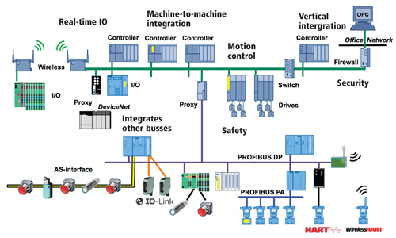
Introduction to Computer System Validation
Types of CSV (cont.)
(Network Infrastructure)

Slide 60
Introduction to Computer System Validation
Types of CSV (cont.)
(Network Infrastructure)
Qualification effort for Network Infrastructure may include, but is not limited to cover:
Physical & Logical Security,
LAN & WAN/Cloud Servers,
Software Application Tools,
Wiring Closets,
Wireless Connections, and
Data transmission integrity
Note: It is strongly recommended that do not link Network Infrastructure qualification effort to any particular GxP software application validation.

Slide 61
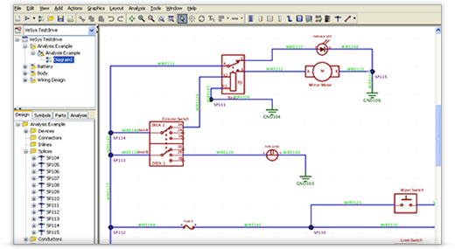
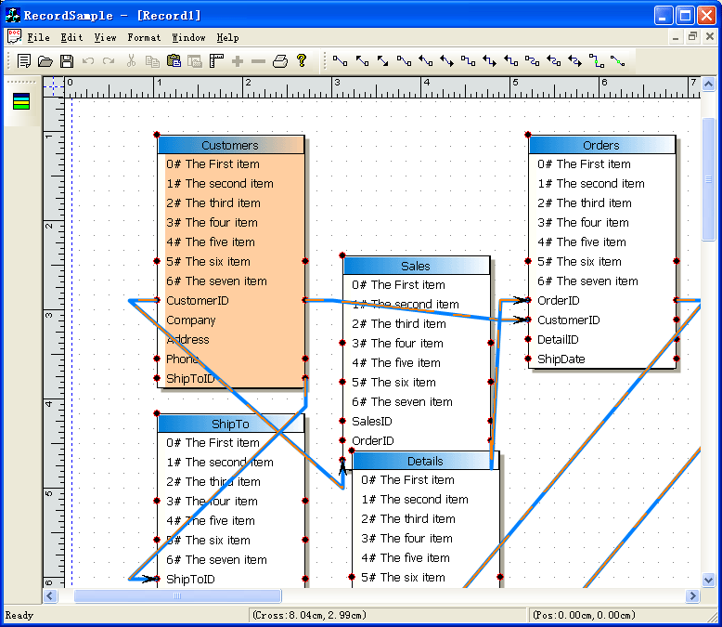
Introduction to Computer System Validation
Types of CSV (cont.)
(Software Application)
PLC Ladder Logic
Database using C++

Slide 62
Introduction to Computer System Validation
Types of CSV (cont.)
(Software Application)
Validation effort for any GxP Software Application may include, but is not limited to cover:
Physical & Logical Security,
Functional Requirements,
Access Levels & Functions Enable per Access Level
Screen Navigation
Parameter’s limits
Backup & Restore and Disaster Recovery
Note: It is strongly recommended that do not link a GxP software application validation effort to any other particular GxP software application.

Slide 63
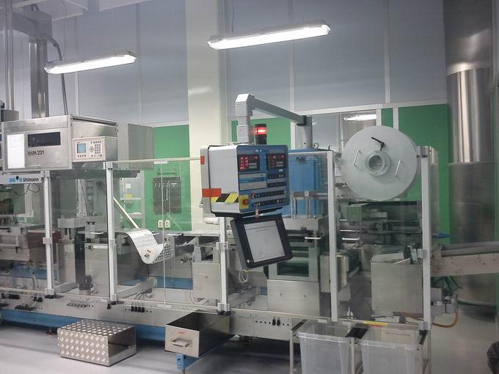
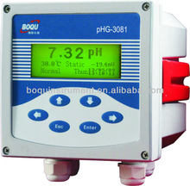
Introduction to Computer System Validation
Types of CSV (cont.)
(Equipment/Instrument controlled by Software)
Sealing machine for blister packs
pH Meter

Slide 64
Introduction to Computer System Validation
Types of CSV (cont.)
(Equipment/Instrument controlled by Software)
Validation effort for any GxP Equipment/Instrument controlled by software may include, but is not limited to cover:
Physical & Logical Security,
Functional Requirements,
Access Levels & Functions Enable per Access Level
Screen Navigation & Parameter’s Limits
Analog/Digital Inputs & Outputs Verification
Backup & Restore and Disaster Recovery
Note: It is strongly recommended to keep the validation effort of any equipment/instrument as an individual system, even if its part of a bigger system, such as a packaging line.

Slide 65

Questions?
This is the time to ask!

Slide 66
Covex Contacts
Richard Tabarrini, President
Office – (484) 384-4801
Cell – (610) 608-0091
Michael Zanette, VP, IT Compliance
Office – (484) 384-4802
Cell – (732) 232-2761

